Slide 1

Learn Rust the Hobbes way
Ivan Towlson Fermyon

Slide 2
What is Rust, and why?
Safety
Efficiency
Portability
Expressiveness

Slide 3

What is Rust like?
Hybrid: imperative, object-oriented, functional
Strongly typed
Expression-oriented
Layered: core -> alloc -> stdlib -> third party
Deterministic memory management
Friendly crab mascot

Slide 4
Memory safety in a concurrent world
Immutable by default
Ownership as a first-class concept
Shared and exclusive borrows
Lifetimes as a first-class concept
Compile-time borrow checking
Unsafety

Slide 5
Sharing and synchronising
Immutable by default
Interior mutability: atomics, cells and guards
Shared-ownership containers
Expect to meet e.g. Arc<RwLock<T>>
Send and Sync
What Rust can’t save you from
Mara Bos, Rust Atomics and Locks: Low-Level Concurrency in Rust: https://marabos.nl/atomics/

Slide 6
Memory management you don’t have to look at
Scope and drop
RAII and discards: #[must_use]
Box
Recursive types

Slide 7
Efficient polymorphism
Traits
Expect to meet: Debug, Display, Clone, Default, AsRef, From/Into
Generics
Expect to meet: scary numbers of type params
impl Trait vs Box<dyn Trait>
Return type polymorphism

Slide 8
Efficiency and expressiveness
Express intent… but express it explicitly
Example: iter() / iter_mut() / into_iter()
Documentation can give the wrong impression
Example: self.map(f) -> Map<Self, F>
How big is an Option?

Slide 9
Using macros to do your work for you
Attribute-like macros
Expect to meet: #[derive], #[cfg], #[test]
Function-like macros
Expect to meet:
format!, println! (strings and outputs)
vec! (literals)
matches! (patterns)
assert! (testing)

Slide 10
Dealing with errors
Errors, results and panics
The try operator
#[must_use]

Slide 11
Structure, packaging and distribution
Crates, modules, and visibility
Organisational unit: modules
Distribution unit: crates
“private” vs pub(crate) vs pub
Crate dependencies
Crate features
crates.io

Slide 12
Finding your way around the ecosystem
crates.io and docs.rs
A few libraries you might need / meet:
Infrastructure: serde, tokio
Errors: anyhow, thiserror
Utility: rand, url
Command line: clap
Web protocol: hyper / axum / reqwest
Web application: yew / leptos / dioxus

Slide 13
Why haven’t you mentioned async yet?
Rust async is… different
For good reasons
Lifetimes make async challenging
Expect to meet: tokio (async APIs and scheduling), #[async_trait]

Slide 14
Try it out
Why is the learning curve steep?
What will you gain from climbing it?
“A language that doesn’t affect the way you think about programming, is not worth knowing.” –Alan Perlis

Slide 15
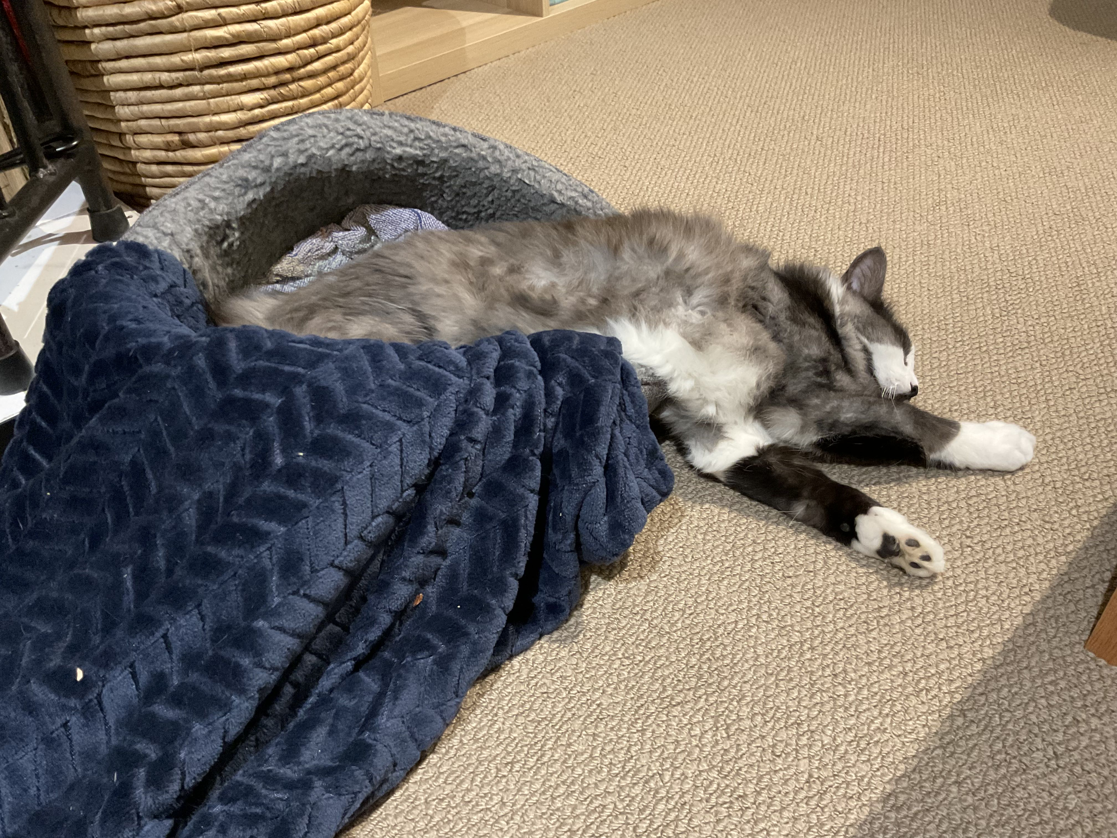
Thanks!
https://www.rust-lang.org/
ivan.towlson@fermyon.com @ppog_penguin@mastodon.nz
(and if you want a professional Rust educator, look up Tim McNamara / @timclicks)

